Slide 1
MiniProject Preparation
Plotting different types of data
CheckIn Code: 182171

Slide 2
Things you’ll need
CheckIn Code: 182171
VLE page: Advanced Topics and Practical > PC Workshops > Miniproject Preparation
Download the file “data_and_scripts.zip”.
Unzip this file (Extract All…), and open the resulting folder in File Explorer
Download and open this presentation.

Slide 3
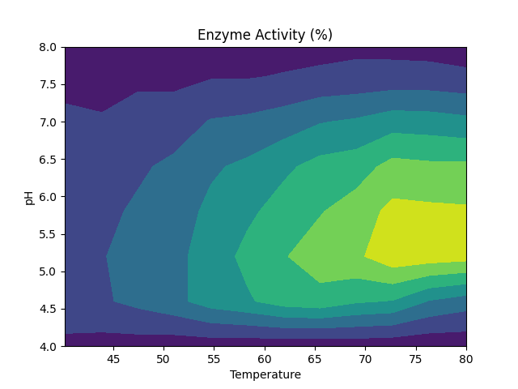
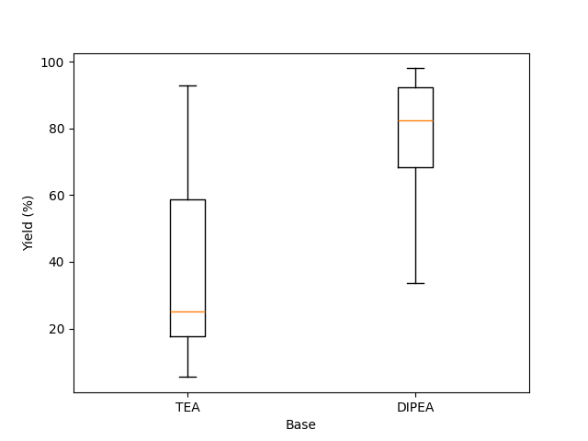
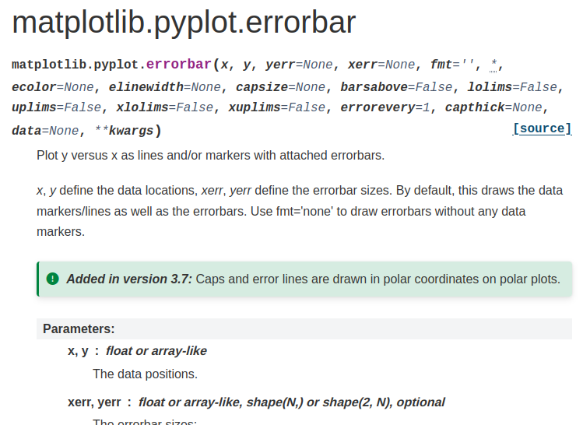
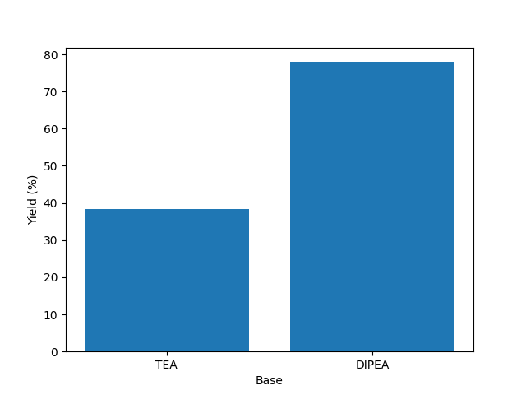
Today’s goals
How to make different types of plots.
What is the best way to plot data?
How to read documentation.

Slide 4
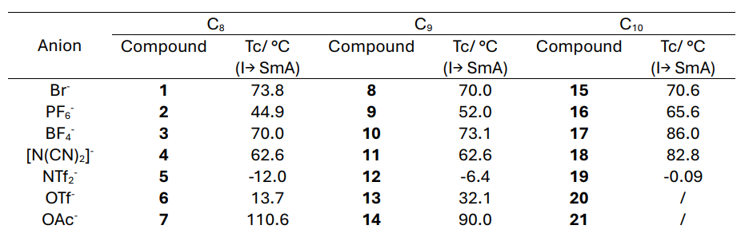
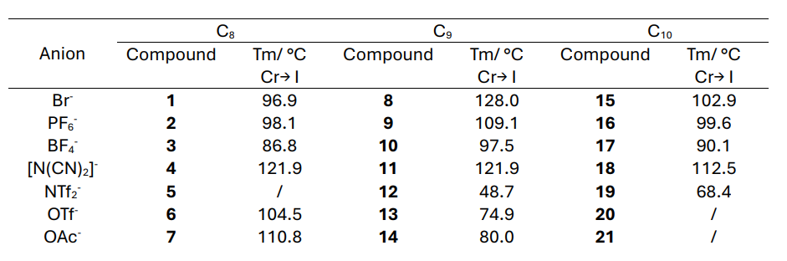
1. Decisions Decisions…
The tables on the right show the clearing temperatures (above) and melting temperatures (below) for a series of liquid crystals of different chain lengths (C₈, C₉, C₁₀) and counterions.
How many different ways can you think of to display this data?
What reasons can you think of to choose one method over another?

Slide 5
2. Plotting with error bars
The first graph we want to create plots the % change in ozone concentration against the % change in the emission of VOCs from different sources. Our first attempt at this can be found by running:
python ozone.py
To run this, open a Terminal window (right click in the folder which contains the Python scripts), and type the instruction above.
The script should run, and will create a graph from the file as a .png (which gets saved into your working directory, you can access the image in File Explorer). I actually remembered to label the graph this time!

Slide 6
2. Plotting with error bars
However, if we open the data file (vehicular.txt), we can see we have error bars on each point. It would be good to show these as well!
There’s a python function for that: plt.errorbar. Let’s check the documentation.

Slide 7
2. Plotting with error bars
Replace plt.plot with plt.errorbar, and add the third column of data in vehicular.txt as the y error bars.
Reminder: to select a column of a numpy array, use [:,m] after the variable name to get the (m-1) column.
Optional: Add a format string (see the “notes” section of this documentation).

Slide 8
2. Plotting with error bars
Let’s make this graph even more useful:
Read the data from paint.txt and solvents.txt.
Add a line, with error bars, for each of those data sources, labelling them appropriately.
Optional: Let’s make the graph even more beautiful.
Make every line formatted differently, with different colours and patterns.
Add a cap to the end of the error bars (check the documentation).

Slide 9
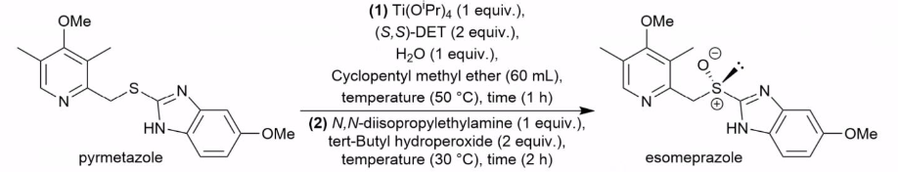
3. Summarising data
For our next graph, we have a new dataset in green.csv. Open it to take a look at what the data looks like.
It contains a series of reaction conditions for the reaction above, with the yield and enantiomeric excess for each listed.
We want to see the effect of changing the base between TEA and DIPEA.

Slide 10
3. The Pandas library
Today we are using a new Python library called “pandas”. It is similar to numpy - in some ways easier to use, and in some way more confusing (IMO).
Loading data
data = pd.read_csv('green.csv')
Selecting data
tea = data[data['Base']=='TEA']
Accessing data
tea_yield = tea['Yield (%)'].values

Slide 11
3. Summarising data
Modify yields.py to add a box plot or a bar chart to show the effect of changing the base.
Create a new variable which contains only rows of the data where the base is DIPEA.
Create a variable which only contains the yields from the rows above.
EITHER Box plot:
Look up the matplotlib documentation of a box plot, and create a box plot of the reaction yields when TEA and DIPEA are the bases.
Add labels to the two box plots (see the “tick_labels” option).
OR Bar Chart:
Use a numpy function to calculate the average yield when TEA and DIPEA is the base.
Look up the matplotlib documentation of a bar chart, and plot these averages on a chart.

Slide 12
3. Summarising data

Slide 13
4. 3D data
Sometimes we have data which depends on 2 variables, and we want to show the effect of both at the same time. For example, activity.txt shows how the % activity of an enzyme varies with both pH and temperature.
Run
python contour.py
Then decorate your plot to make it beautiful.
Add axis labels, a title, and a colorbar.
Try using filled contours with the function “contourf”.
Modify the colours of the plot, using either the argument “color” to specify a list of colours, or “cmap” to use a predefined colourmap. Available colours and maps.
Check the other arguments in the documentation for further modifications.

Slide 14
4. Multiple plots
Back to reaction data - have varying solvent as well as base.
Is yield correlated with EE?
Does that depend on Solvent choice/ Base choice?

Slide 15
4. Multiple plots
It can be helpful to split data across two plots, to make sure a single plot doesn’t become too cluttered. Thankfully there’s an easy way to do that in Python (multiplot.py):
fig, ax = plt.subplots(1,2)
This creates one Figure (controlled by the variable fig) with two sets of axes. These are stored in a list in the variable ax: ax[0] is the first plot, ax[1] is the second.
To modify a particular set of axes, we can run ax[1].function_name(). For example
ax[1].scatter(tea_yield,tea_ee)
creates a scatter plot on axis 1.

Slide 16
4. Multiple plots
To see our starting point, run
python multiplot.py
Then complete the following steps:
On axis 0, add a scatter plot of the yield against enantiomeric excess when the solvent is CPME.
Add x axis labels to both sets of axes, and a y axis label only to the left hand axis.
Make sure that the scale of the y axis is the same in both plots.
Add a title to the figure (not the axes).
Advanced: For each set of axes (and therefore for each solvent separately), plot a scatter of the yield against enantiomeric excess when the base is TEA and DIPEA separately. Add a legend.

